Slide 1
Warm Up
Take out your Rig Veda text from yesterday
Complete the first side of the worksheet on your desk

Slide 2
Agenda
Warm Up
A brief history of Hinduism
The Upanishads & India Philosophy
Why the Caste system isn’t all that bad??
The Mahabharata & Bhagavad Gita
Dharma
Gods
HW: Read Washington Post Article on the Bhagavad Gita, be prepared for short reading quiz on Socrative on Monday

Slide 3
Essential Questions for today
Can the caste system be viewed positively in light of the Indian philosophy?
Is Hinduism monotheistic or polytheistic?
Food for though: Is Christianity really monotheistic?

Slide 4
Next Week
The Hindu Epic: Prince Arjuna
http://www.youtube.com/watch?v=6K-R-Q0YRtQ

Slide 5
What you need
1 page in your notes to create a timeline
Your Hinduism Vocabulary Sheet on the back of your map section
Notes:
Go to doc camera and create outline of Hinduism: Review Aryans & Vedic Texts, Brahamism

Slide 6
Upanishads
Texts that form the basis for Indian Philosophy and are important to Hinduism
Written between 900-500 BCE by Brahmin priest

Slide 8
Brahman: the source of all life, sometimes incorrectly compared on God in Judaism, Christianity & Islam “All Life is Connected”
Notes:
The difference is that braham is not personal and does not act in the world, the world is made up of Brahman. Some more mystical interpretations of God in western tradition can be compared, but not the traditional version

Slide 9
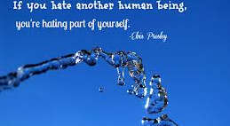
Atman
The unchanging eternal self
Can be compared to the soul in western thought
In Hinduism Brahman = Atman

Slide 10
Gods & Avatars
Fun Fact 1: Hindus believe in 320 million Gods
Main gods are Brahma (creator), Vishnu (preserver), Shiva (destroyer)
Everyone is allowed to have their own Gods, because everything is part of Brahman.
Fun Fact 2: If you have really good Karma you might get reincarnated as a God
Fun Fact 3: All religions have a place in Hinduism….Jesus and Mohamed are considered Avatars in Hinduism (an incarnation of the eternal Brahmin)

Slide 11
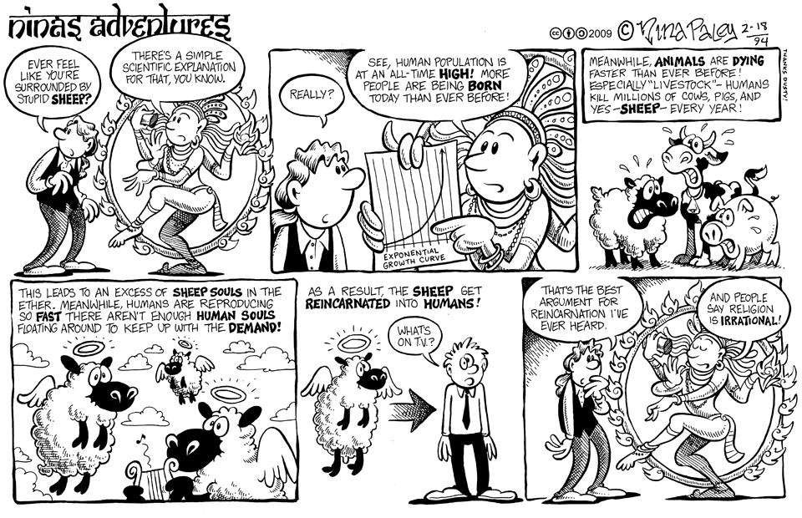
Samsara
The Hindu word for reincarnation

Slide 12
Dharma
Duty or Right Behavior
Notes:
Answer questions about pictures on the back of the document here
Show circular view of life and connection of each spoke of the wheel to to whole.

Slide 13
Karma
What goes around comes around…..
In your next life!
How do you keep your karma good?

Slide 14
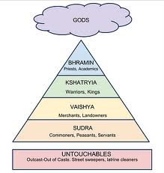
Hindu Caste System
Social structure in
Hindu society

Slide 15
Moksha
Life is hard, death sucks……
Moksha is getting out of of the cycle of re-birth. It is the ultimate goal for a Hindo
All devotional practice are geared towards helping a person achieve Moksha

Slide 16
In Summary
All things are connected Brahman
Do you duty Dharma, stay in your Caste
Don’t worry to much about this life, it will happen again in Samsara, but get out if you can with good Karma, into Moksha

Slide 17
Mahabharata & Bhagavad Gita
Epic Poem about how to act in this world in order to follow the Dharam and get good Karma
Most popular Hindu text
5 times as long as the Odyssey
Conversation between Krishna & Prince Arjuna about Dharma or Duty to ones caste

