Slide 1
Warm Up
Watch Video clip and answer the questions
Why is this speaker citing the prophets?
How does he believe the prophets will help us?

Slide 2
This week we will Answer
Who were the prophets?
How did they form the backbone of the Jewish kingdom and Jewish thought?
What other historical information do we have about events mentioned in the Bible?
When was the bible put together and how did historical events shape the worlds most famous book?

Slide 3
Judaism Pre Test
What is Moses’s role in the Hebrew Bible?
How many books are in the Old Testament?
What is a Jewish religious leader called today? In the ancient world?
Who was the first king of Ancient Israel?
What does Hanukkah celebrate?
On what holiday was Jesus eating his “Last Supper”
What year was Israel made a Nation? What year did the Jews last rule Israel before the modern nation?
Notes:
24 Books in TNK (torah 5 books, Niviyim & Kituvim (history & psalms) , Saul, David, Solomon,

Slide 4
Timeline
1200 BCE Earliest Evidence of Israelite Settlements in Israel
1000 BCE King David is around
960 BCE King Solomon is around

Slide 5
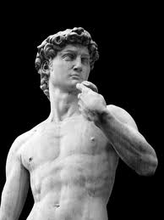
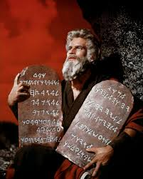
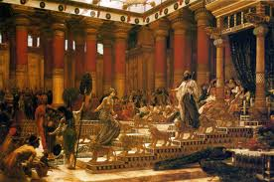
Founding Fathers
Conflicting Historical Evidence
Great Kings or Tribal Leaders?
Earliest Roots of Israelite Kingdom
.
No outside historical evidence
Founder of Israel
Brings early Israelites out of slavery in Egypt

Slide 6
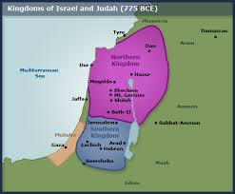
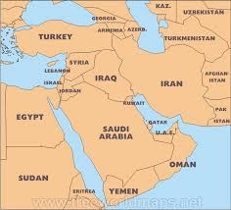
Timeline
800 BCE Kingdoms of Israel & Judah
722 BCE Assyrian conquer Israel
AXIAL AGE TRANSFOMATION BEGINS WITH PROPHETS: Jeremiah, Isaiah
586 BCE Babylonians exile Israelites to Babylon
332 BCE Alexander the Great Conquers Israel

Slide 7
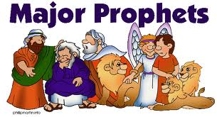
Prophets
Prophet = Oracles, Just Like China & Greece
Advise Kings of Israel
Preach to the people about their behavior
Communicate with gods or God
19 Prophets mentioned in Hebrew Bible

Slide 8
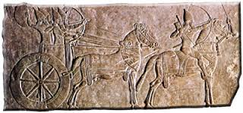
Prophets
Amos, Hosea & Isaiah
Amos and Hosea advise Northern Kings of Israel
Isaiah advises Southern Kings of Judah
Assyrian Invasions between 730-720s BCE

Slide 9
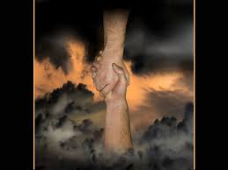
Prophets
2 Key elements in the texts
Oracle: Prediction about the future in order to advice the King on his affairs
Usually related to historical events
Lawsuit against the people for their behavior
These are some of the first people in world history to attach moral behavior to their relationship with gods

Slide 10
Prophets
You will read several section from the Prophets of Isaiah and Hosea in order to determine their moral outlook and their historical context
Read the text and determine if it is an Oracle or a Lawsuit
Summarize the text in your own words
Draw a conclusion from the text: What have you learned about history or religious beliefs from the text
YHWH = Israelite God = El or Elohim

