Slide 1
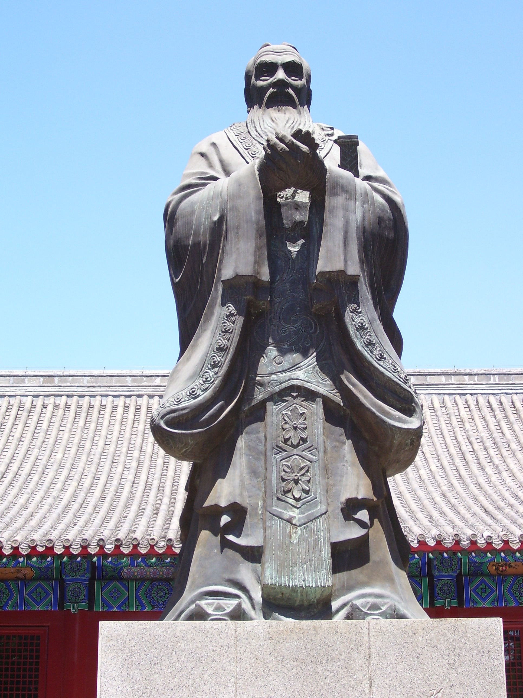
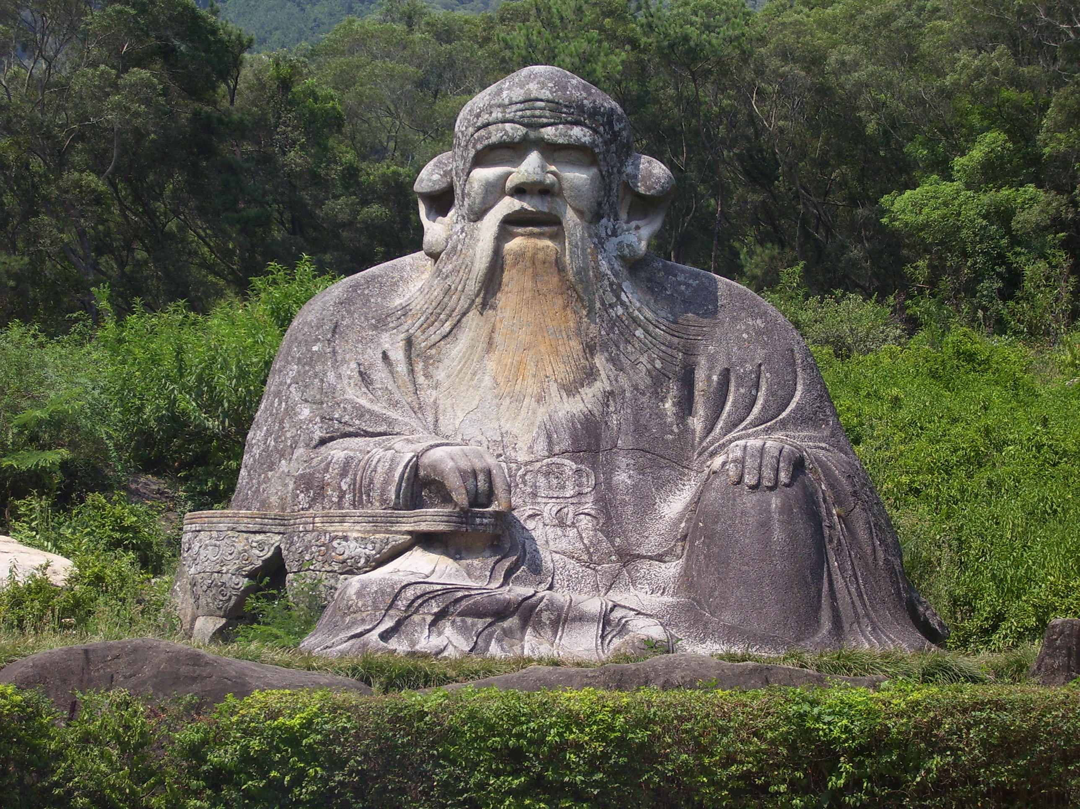
Philosophy through Art

Slide 2
Religion or Philosophy
What is the difference?
What do we think of Buddhism?
By the end of the week you should be able to decide.

Slide 3
Ancient China Timeline Review
1500 – 500 BCE: Shang & Zhou Dynasty
500-221 BCE Warring States Period
  What else is taking place in other parts of the world during this time frame ?
  Daoist (Taoist) & Confucius (Kong-tzi) found philosophies
221 -206 BCE Qin Dynasty
  Emperor Qin & Terra Cotta Warriors
206-220 Han China (Classical China)
  Confucius, Bureaucracy, Buddhism, Silk Roads trade, Great Wall, Paper, 2000 years of legacy
The Axial Age in China: Foundations of Confucianism & Daoism
Notes:
Begin creating prounuciation chart on paper

Slide 4
Agenda
Visuals of Confucius & Daoists
Review of China Timeline
Questionnaire
Confucius Jigsaw Reading

Slide 5
Readings
Leave 5 lines between each heading
Early Zhou Dynasty
Late Zhou Dynasty
Childhood
Career
Followers
Confucianism in Han China

Slide 6
Instructions
DO NOT WRITE ON THE TEXT, ONLY WRITE IN YOUR NOTEBOOK
List the 3 most important points from your paragraph (include dates if needed)
Draw a simple illustration for each idea
Add any important events to your timeline
Be prepared to share your notes with your group

Slide 7
Group Share
Share your notes in Chronological Order
Complete the timeline worksheet
  Your timeline will be turned in at the end of the week

