Slide 1
Warm Up
Take out you Mesopotamia & Beer Article and have it ready to review
Move on Syria:
If you favor an attack on Syria please go stand on the window side of the room
If you do not favor an attack on Syria please stand on the door side of the room

Slide 2
Agenda
Warm Up: Syria
HW: Respond to Blog Articles posted about Syria by Thursday @ 11:59 pm. Follow up discussion on Friday.
Review & Lecture on Mesopotamia
Jigsaw the textbook
Presentations on Mesopotamia (continued tomorrow)
Later this week: Comparing Stories, Quiz

Slide 3
Review
200,000 YA humans arise
40,000 YA first evidence of culture and art
9,000 BCE farming
3400 BCE first city-state and writing emerge
What role does Beer play?
Why Does Writing Emerge?

Slide 4
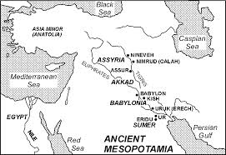
Phoenicians
Notes:
Land between 2 Rivers
5 major civilizations: Sumerians, Babylonians (2 empired old and new) Akkadias, Assyrians
Fertile Crecent extend all to way down to Egypt

Slide 5
1st Empires
3200 BCE City of Uruk arises Sumer Region (Modern Kuwait, Southern Irag)
2300 BCE 1 Empire Builder Sargon
1790 Hammurabi’s Code
1400 BCE Iron Age Begins
1100 BCE Assyrians 1st Real Multicultural Empire
700 BCE Phoenicians do some crazy stuff!

Slide 6
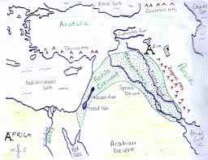
Mental Maps
Notes:
Mental Maps: A way to draw a quick map using your memory to help you remember the locations and relationships of important features in history

Slide 7
Jigsaw
Divide into 6 Groups to cover a section of the text book chapter
Geography of Fertile Crescent
Sumerian Civilization
Advances in Learning & Looking Ahead (Writing)
Ruling a Large Empire (First Babylonian)
Warfare & Spread of Ideas (Assyrians)
Phoenician Sea Traders
Create a Poster that includes
Title of you Section
Big Idea statement
3-5 important details that everyone should know
1 illustration that help represent you section

