Slide 1
Warm Up
Take out your homework questions about the article and compare answers?
How does this Amendment help us live up to the ideas promised in the Declaration of Independence?

Slide 2
Key Questions
1. How do we bring the South back into the Union?
4. What branch of government should control the process of Reconstruction?
2. How do we rebuild the South after its destruction during the war?
3. How do we integrate and protect newly- emancipated black freedmen?
Notes:
Question 3: Black codes 14 & 15 amendment and Carpet baggers, free blacks in government
Question 1: Radical Plan- punish the south, don’t give them rights, get blacks involved in gov’t Johnoson’s Plan- make nice, pardon’s people doesn’t deal with blacks
4. President Johnson vs. Radical Republicans in congress

Slide 3
Where Have We been?
Slaves Freed But……?
Fights between Radical Republicans and Johnson
To Punish or Not to Punish
Notes:
Election of 1866 sets up a showdown between Johnson’s ideas and congress’s ideas. Radical Republicans get elected to congress and change the nature of Reconstruction for good!

Slide 4
14th & 15th Amendment
14th Amendment: Equal Protection Clause – no person can be denied equal protection under the law due to race.
What are the right set forth in the Declaration of Independence?
15th Amendment: Right to vote for all males no matter what background

Slide 5
President Johnson’s Impeachment
Impeachment: Process of trial for a president. Must be convicted by the Senate in a 2/3 vote to kick him out of office.
Johnson upsets Republicans and tries to go over their heads
The House impeached him on February 24 before even drawing up the charges by a vote of 126 – 47!

Slide 6
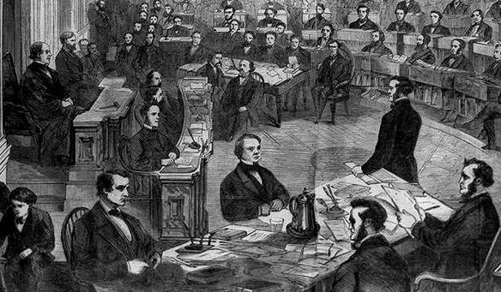
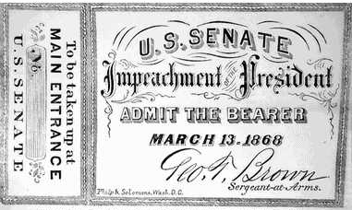
The Senate Trial
11 week trial.
Johnson acquitted 35 to 19 (one short of required 2/3s vote).

Slide 7
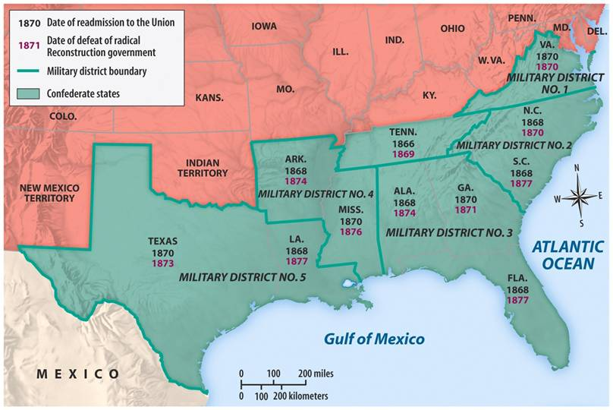
Reconstruction Acts of 1867
Military Reconstruction Act
Restart Reconstruction in the 10 Southern states that refused to ratify the 14th Amendment.
Divide the 10 “unreconstructed states” into 5 military districts.

Slide 8
Progress Made/Lost
Blacks are no longer slaves
Black education through schools
First Historically Black Colleges Formed: Howard (DC) , Morehouse (MLK’s Alma Mata)
Constitutional Voting and Citizenship Rights
Black Codes continue slave trends
Violence toward blacks through terrorism (KKK)
Voting and Citizenship rights limited by supreme courts (the states can decide these things)

Slide 9
Reconstruction begins to Die
How do people feel after 10 years of fighting over reconstruction?
Do you know what’s going on in the Republic of Congo in African?

Slide 10
DBQ: Document Based Question
Who Killed Reconstruction?

Slide 11
Homework
Read all the documents & answer all questions in the packet and come to class with your notes
Be ready to write a 5 paragraph essay to answer the DBQ.
This Essay will serve as you test for this unit.
Reminder: If you are absent check the website
www.mrgarnershistory.weebly.com
check homework and classwork sections for handouts and PowerPoints

