Slide 1
The Cold War Intro

Slide 2
Reminders
Make Up tests
Just War Papers…..I have 13 papers
Do I think it’s a just war?

Slide 3
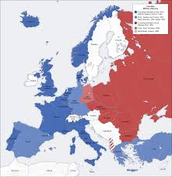
New Unit: The Cold War
Just in time for spring!

Slide 4
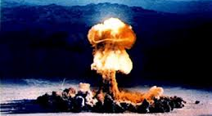
WWII Ends with a Bang
Notes:
This brings a new weapon and way to kill into the world.

Slide 5
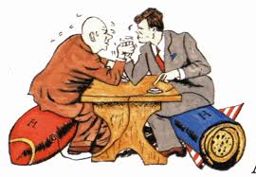
Balance of Power
Notes:
The wrestling between nations to make sure that on one nation cannot control too much power in any part of the world. After the war the US and the Soviets both in engaged in this type of strategy in order to maintain control over their ideology and their territory

Slide 6
What are the consequences of using ”Balance of Power” as a strategy for your policy?

Slide 7
Yalta Conference
1945 Leaders of GB, Soviet Union & US met to discuss post war plans
All the countries would help rebuild parts of Europe

Slide 8
Yalta Conference
Germany was divided in East & West Germany
East = Soviet West = US & GB
Berlin was divided in East & West
Eastern Europe was Soviet influenced
Western Europe was US influenced
Tensions between the Soviets and the US began to rise because of Balance of Power

Slide 9
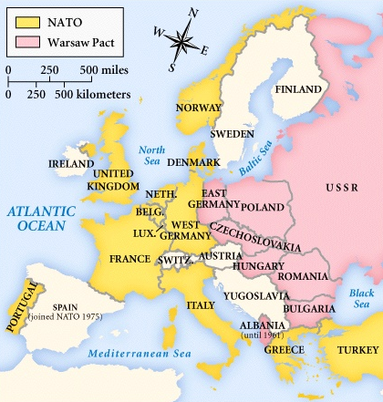
NATO Treaty, 1949. Warsaw Pact, 1955.

Slide 10
Crash Course Cold War
https://www.youtube.com/watch?v=9C72ISMF_D0&index=40&list=PL8dPuuaLjXtMwmepBjTSG593eG7ObzO7s

Slide 11
Who/What caused the Cold War?
Iron Curtain Speech
Truman Doctrine
Wallace Letter
Soviet Telegram

Slide 12
Close Reading
Source Each document
Write directly on your page
Read through the document & underline 2-3 key phrases that stand out to you
Summarize your document
In 1-2 sentences what is the main message of the document

Slide 13
Partner Work
After you have read, work with your partner to fill out the questions
Form an hypothesis: Based on the documents, who/what was responsible for the cold war?

Slide 14
Homework
Using your text book or the internet
Finish the terms handout you received
What is the terms
How is it related to the Cold War?
Next Time: The Cold War gets Hot, almost!
We will begin a movie on the Cuban Missile Crisis

