Slide 1
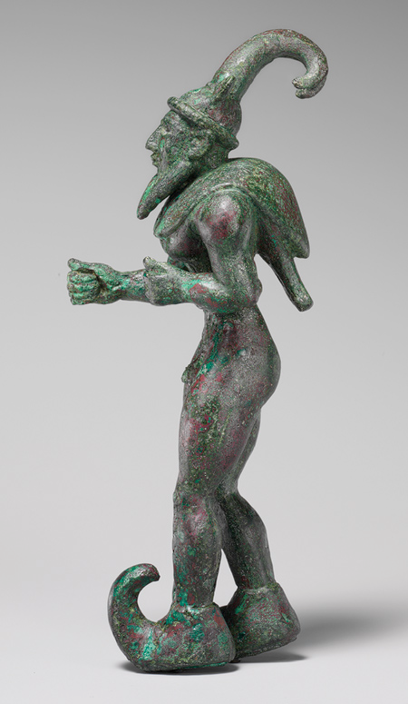
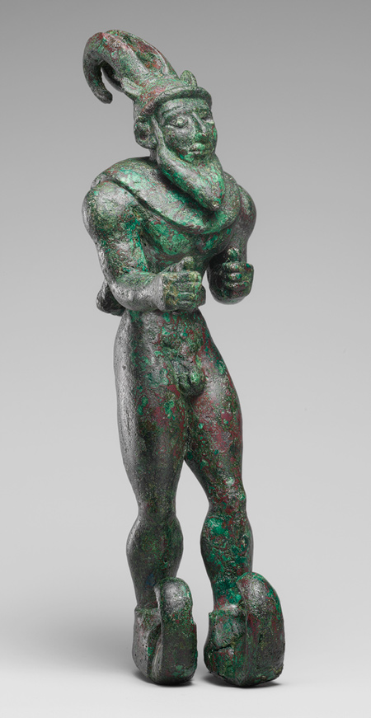
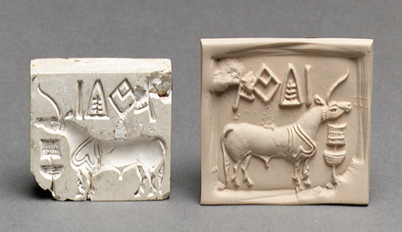
Warm Up:
Observe the following pieces of Mesopotamian art and
1. What is it? Describe the piece below in detail. Feel free to sketch a piece in your notes
2. What is it used for? Predict its use.
Notes:
Horned Demon 3000 BCE copper, first realistic depictions of humans in art, combining of human and animal charateristics with horns and wings around sholders. Possible early religious beliefs, possible shaman figure that had spiritual power.
Seal Stamp 2600 BCE Use to mark ownership or sale of something. Includes a persons personal seal to

Slide 2
Agenda
Warm Up
Hand back work
Presentations
Primary Source Backgrounds
Sourcing

Slide 3
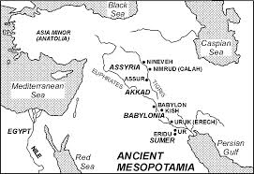
Phoenicians
Notes:
Land between 2 Rivers
5 major civilizations: Sumerians, Babylonians (2 empired old and new) Akkadias, Assyrians
Fertile Crecent extend all to way down to Egypt

Slide 4
Jigsaw p 34-39
Divide into 6 Groups to cover a section of the text book chapter
Geography of Fertile Crescent
Sumerian Civilization
Advances in Learning & Looking Ahead (Writing)
Ruling a Large Empire (First Babylonian)
Warfare & Spread of Ideas (Assyrians)
Phoenician Sea Traders
Create a Poster that includes
Title of you Section
Big Idea statement
3-5 important details that everyone should know
1 illustration that help represent you section

Slide 5
Presentation
Each Person in the group should share at least one piece of information from the Chapter
Remember your classmates did not read the chapter on this and will be quizzed on the information on Friday…Help them out!
Audience members need to show respect and attention to presenters….Presenters should show the same type of respect for audience

Slide 6
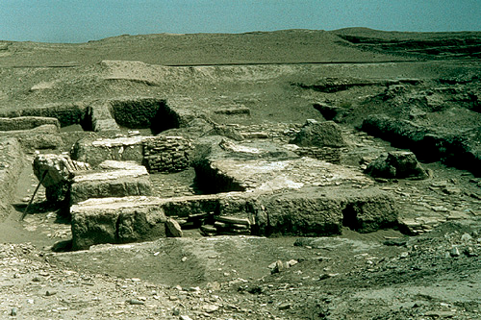
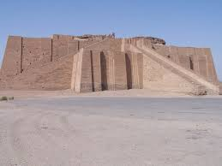
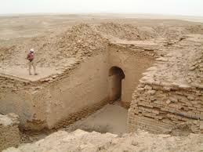
Where is the River & Farmland?

Slide 7
Human Nature
Why do we have religions?
Why do we have stories?

Slide 8
Rules of Ancient Religions
Religions satisfy or explain a need of the people
Religion is not separate from anything else in society
People trade religious ideas
Religions evolve
Religions must be studied in context just like all other history
Notes:
Judaism changed after 1800’s in Europe and again after the Holocaust to help people answer different questions….Christianity had many different early versions that look little like the Medeival Catholic Church…protestant reformation deal with changing European world. Buddhism exists in 100s of different forms that are adapted to different cultures….anthropologists didn’t even realize it was connected to one religion (but that’s because the concept of A Religion didn’t really exist to those people).
Judaism changes its ideas significantly when ideas from Persia taken during the Jews captivity in Babylon….the silk roads allowed religions to mix for thousands of years creating whole forms of religions that historians have had a hard time defining.

Slide 9
Key Words
Polytheism- many deity
Monotheism- one personal creator deity
Atheism- belief in no god, and usually associated with someone who is not religious at all. In history this sometimes just meant that believing in god in the “right way”
Nontheism- covers many beliefs that do not include a creator god. Buddhism and Jainism and other forms of religions could still be considered non-theistic

Slide 10
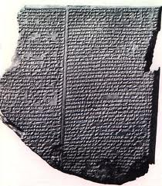
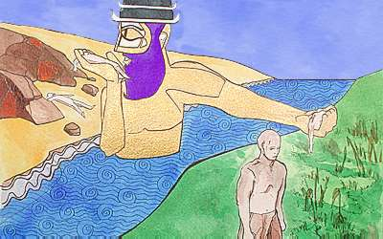
Ancient Stories
Notes:
Epic of Gilgimesh is put together from different Fragments dating from the 2000s-1300s BCE combines Sumerian and Akkadian versions together
Above is the famous flood table
“When On High” Mesopotamian Creation Epic again later versions were found more complete but we know that texts existed early and have found some evidence of this

Slide 11
Source it & Contextualize it

Slide 12
Enuma Elish
Source it by reading the introduction
Who wrote this
When was it written? Are there multiple dates
Where was it written?
Why was it written?

Slide 13
Warm Up: Review the Creation Myth from Yesterday
What is the motivation for creating this myth? Based on this myth what types of lives did people have in ancient time?
Humans serve the Gods in the myth because the Gods are lazy and don’t want to do work….what does this say about how the humans view their own lives?
How is Marduk viewed by the people? How are the other gods viewed?
Do people today have similar motivations and stories?

Slide 14
Creation Epic
The word has a definite beginning and possibly an end: Linear view of history
The world is chaotic and beyond human control because the gods are in conflict
Floods, droughts, bad weather, death, disease are out of human control
Humans serve the gods expresses how people feel about themselves
Like slaves, lack control, negative view of life, uncertain
Every city or civilization has a favorite god that does go things and gods to blame for bad things
We do this today in our politics (rep v democrats), with out sports teams, with our religions (my god vs your god)

Slide 15
Agenda
Warm Up
Settler of Catan
Quiz Review
RECIPE for Civilization
Gilgamesh: Video Clip& Text
Wrap Up Question

Slide 16
Gilgamesh
Watch the Gilgamesh Cartoon
Answer these questions in your notebooks
What does this story help explain to the people of Mesopotamia (think about what it was like to live there 5,000 YA)?
Why is there is flood? What does this say about the gods?
What are some explanations as to why this story might be the similar to the biblical story of Noah? Why is it not exactly the same?

