Slide 1
Agenda
Essay rewrite due today!! If I missed yours turn it in
Quiz on Peace Treaty
Introduction to the 1920’s
Returnt to Normalcy
The Scopes Trial
What clashes between different points of view are brought up in this trial?
Primary Source Analysis
Group Work
HW: Find 2 articles in the Editorial/Opinion Section of the news paper where they author makes an argument for an issue
Who is the source, What is his thesis statement? What evidence does his use to support it? It it convincing?

Slide 2
Peace Treaty Quiz

Slide 3
1920s: Return to Normalcy
What is Normalcy?
How were things before the war?
What conflicts are going on in the US that we have covered so far that have not been resolved?

Slide 4
Normalcy
Return to Normalcy:
Isolationism vs Foreign Relations
Nativism
Segregation & Racism
Labor vs Big Business
Gov’t vs the People
Communism & Socialism
Conservatives vs Progressives
Religious Tensions

Slide 5
A Historian’s Analysis
It has often been the case, that after a major national crisis such as a war, Conseravtives and Liberals often engage in a battle for control of the culture of the US.
Is this the case?
Can we find evidence in the 1920’s of this battle?

Slide 6
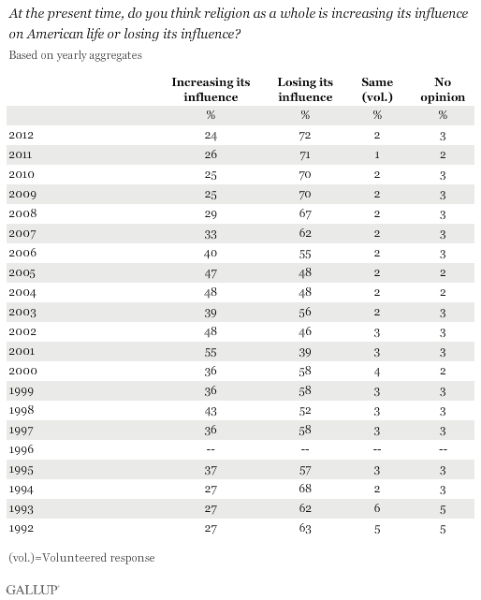
At what point do you see a big jump in the numbers
Why?

Slide 7
Headlines in US after 2001
Kansas education school board votes on standards that doubt the validity of Darwin
Judge Rules against teaching of “Religious Alternative” to Evolution in Pennsylvania Schools

Slide 8
1920’s : An Introduction
Notes:
Play movie through 54 seconds

Slide 9
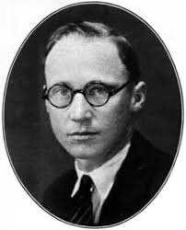
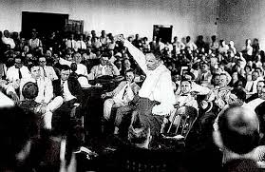
Scopes Monkey Trial 1925
John Scopes was asked to protest a law banning the teaching of evoltuion in Tennessee Public Schools
Went to court for teaching evoltuion and breaking the law
John Scopes vs State of Tennessee
What happened?
Why did it happen?
Why should we care?

Slide 10
The Question
What evidence can we find that the Scopes trial shows us conflicts between different parts of society?
Conservative
Progressive

Slide 11
Document Analysis
Each person has a different perspective on the trial
Source your document:
Who wrote it? What is their perspective? What do you think their Bias would be (are they for John Scopes or Tennesssee Law)
Read your document 1 time through
Read your document a second time
Underline 2-3 key phrases in your document that stand out to you

Slide 12
Same Document Groups
Each person in your groups Pick 1 quote you underlined
1 minute to read your quote and explain why you think its an important quote
1 minute for group to respond to quote
Repeat this for each person in the group
Each person must share a different quote
On 1 post-it answer the following questions. Everyone in the group should have the same answers
Who is the audience?
What is the main argument of your document? In 1 sentence
What problems does your author see with American Society?

Slide 13
Different Group
Share your post-it with your groups
Make sure to explain the main idea of your document
Place you post it on the continuum
Conservative ---------------- Progressive

Slide 14
Quick write in your notebooks
Based on your discussion with your group members:
Summarize the main conservative and progressive arguments in the scopes monkey trial
Based on the evidence, what do you think will be the result of the trial: Will Scopes be convicted, or will the law be overturned?

Slide 15
What happened
The law is upheld until 1967 inTennessee, evolution is not taught in the school system. Several other states pass similar laws that last until the 1970

