Slide 1
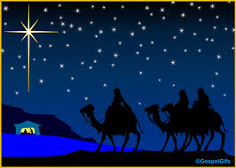
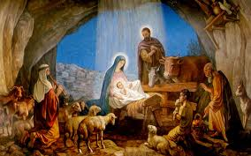
What is happening in these scenes? Be detailed in your descriptions

Slide 2
Themes in Christian Religion
Persian
Virgin Birth
Divine Savior of mankind
Visit of 3 wise men called Magi
Battle of God vs Evil until a cosmic Judgment day at the end of time
The Devil is battling for the soul of people against a moral, loving god
Bad people go to hell, good people are redeemed and go to heaven

Slide 3
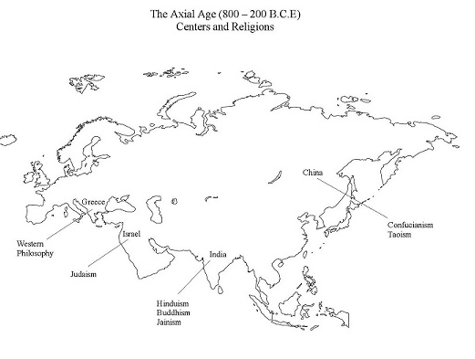
Axial Age
Zoroaster, Persia

Slide 4
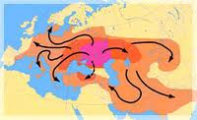
Ancient Aryans
From Steppes north of Iran
All modern languages in Europe and India are derived from them
Indo-European Languages
Made 2 distinct migrations:
East into India
West to Europe
2000 BCE

Slide 5
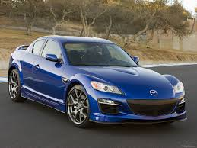
Familiar Words
Caucasian= People from the Caucasus Mountains
Aryan = The Nobel Ones
Iranian
Ireland
Dyaos = Aryan higher God = Zeus
Ahura = Lord
Mazda = Wisdom

Slide 6
More Familiar Words
Devas (Shiny Ones) Lesser Gods
Diva & Divine come from Indian version of the word
Devil comes from Iranian version of the word

Slide 7
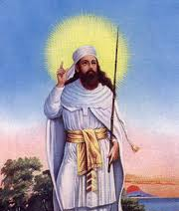
Zoroaster

Slide 8
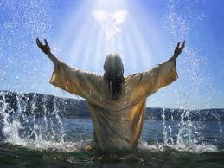
Zarathustra
Lived between 1500 BCE & 800 BCE
????????? What
Worlds First Prophet
First religious leader of Axial Age
Has a vision by a river at age 30
Buddha
Mohammad
Ezekiel
Jesus
What will happen to you when you turn 30?
Notes:
Watch video segment here: http://www.youtube.com/watch?v=GGRgzFLcMMQ

Slide 9
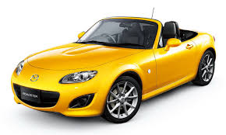
Beliefs of Zoroaster
Simplifies the gods to create a “Pre-Monotheism”
Supreme God of Good: Ahura-Mazda
Evil God Deva (Devil)
Humans have a moral choice
Between good and evil
Moral Agency

Slide 10
Beliefs of Zoroaster
Virgin Birth → Divine Savior of mankind
Battle of God vs Evil until a cosmic Judgment day at the end of time
The Devil is battling for the soul of people against a moral, loving god
Bad people go to hell, good people are redeemed and go to heaven

Slide 11
Did you Know?
There is no concept of afterlife in the Hebrew Bible
Satan is not the Devil and is barely mentioned
Later writings of Jews while they are in contact with Persians show evidence of Zoroastrian thought
Hebrew Texts were not put into finalized form until after Cyrus the Great…..
Basic structure of Christian thought reflects a heavy Zoroastrian influence
Did Zoroaster prophesize about the coming of Jesus?
Did Christians just borrow ideas from Persians?

Slide 12
Why Don’t we know about them today?
There are about 150,000 living in the world today
Mumbai Indian is the world hub of Zoroastrians
Eastern Iran has native populations
Notes:
http://www.youtube.com/watch?v=a4ezRTvDrqw

Slide 13
Questions
What factors have cause Zoroastrians to decline over time?
What solutions do current Zoroastrians have in order to preserve their religion and culture?
Why is intermarriage a huge issue for them?

